Slide 1
Unit 2: Organizing
A MANAGEMENT FUNCTION

Slide 2
Organizing: Key Terms
Organizing: The process of arranging people and other resources to work together to accomplish a goal
Organization structure: The system of tasks, workflows, reporting relationships, and communication channels that link together diverse individuals and groups

Slide 3
Organizing: Key Terms
Organization chart: A diagram describing reporting relationships and the formal(official) arrangement of work positions within an organization and how the organization is intended to function.
An organization chart identifies:
The division of work
Supervisory relationships
Communication channels
Major subunits
Levels of management

Slide 4
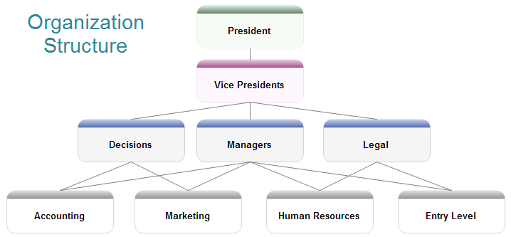
Formal vs. Informal Structures

Slide 5
Informal Structures
Behind every formal structure typically lies an informal structure, which is a set of unofficial working relationships between organization members
ADVANTAGES
DISADVANTAGES
Help people accomplish their work
Gain access to interpersonal networks
Informal learning
Connect with people who can assist in task performance
May work against best interests of organization as a whole
Susceptibility to rumour
May carry inaccurate information
Breed resistance to change
Divert work efforts from important objectives
Feelings of alienation

Slide 6
Traditional Structures
Functional Structures
Divisional Structures
Matrix Structures
Departmentalization: The process of grouping people and jobs into work units.
Top-Down Approach to Organization

Slide 7
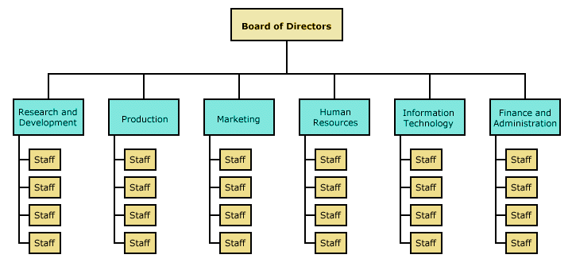
Functional Structures
Functional Structures: Groups together people with similar skills who perform similar tasks

Slide 8
Functional Structures
Advantages:
Economies of scale
Task assignments consistent with expertise and training
High-quality technical problem solving
In-depth training and skill development
Clear career paths within functions

Slide 9
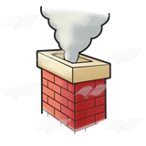
Functional Structures
Disadvantages
Difficulties in pinpointing responsibilities
Functional Chimneys Problem: lack of communication and coordination across functions
Sense of cooperation and common purpose break down
Narrow view of performance objectives
Excessive upward referral of decisions

Slide 10
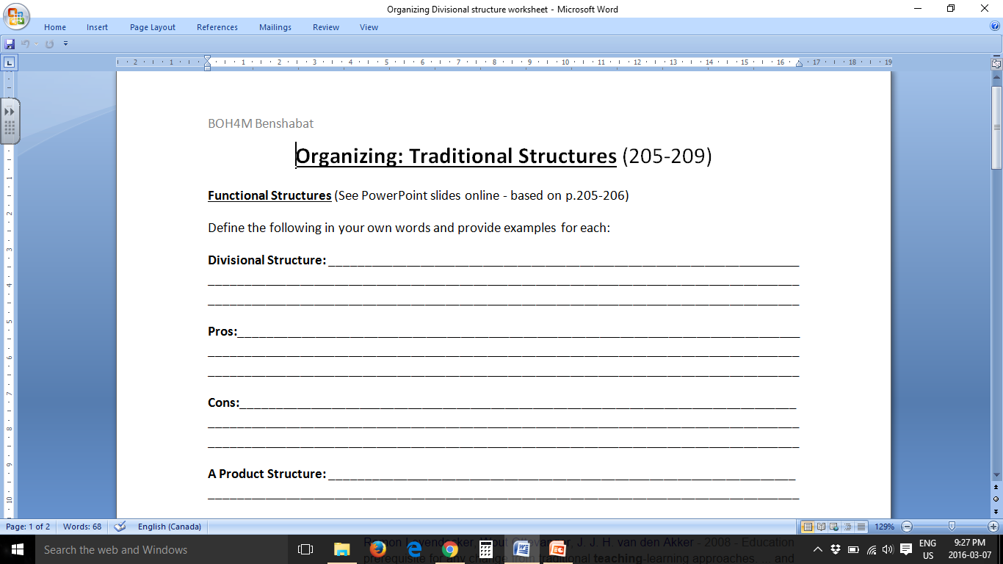
Divisional Structures

Slide 11
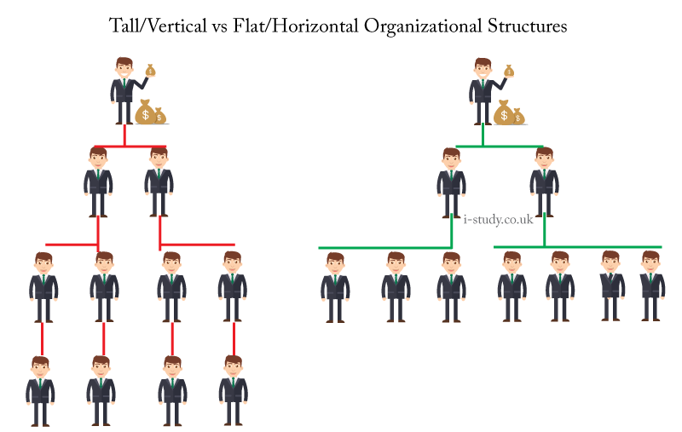
Horizontal/Flat Structures

Slide 12
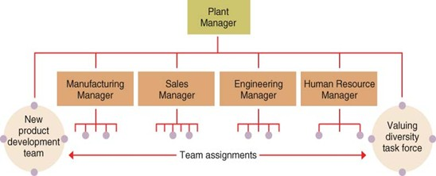
Team Structures

Slide 13
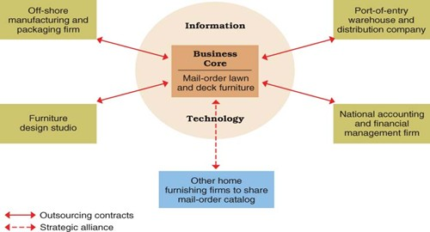
Network Structures

Slide 14
Boundaryless Structure

Slide 15
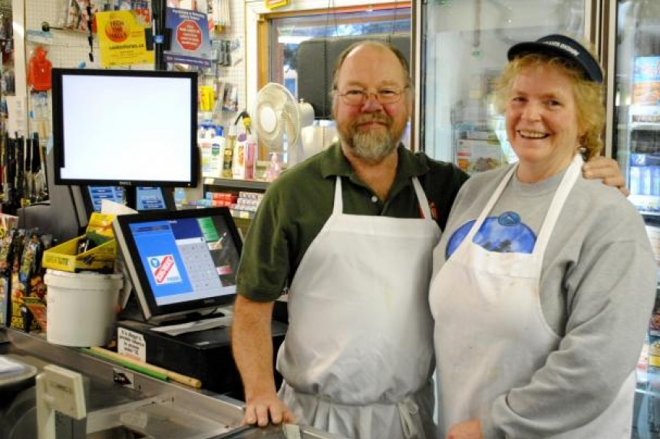
Boundaryless Structure

Slide 16
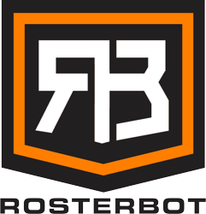
Virtual Organization

