Slide 1
Modern management foundations
Tools, Approaches and Perspectives used in today’s workplace

Slide 2
Quantitative analysis and tools
Management Science and Operations Research
  The scientific application of mathematical techniques to address and help solve management problems (Quantitative Approach)
  Use of staff specialists to help managers apply techniques.
  Software and hardware developments have expanded potential quantitative applications to managerial problems.
  Good judgment and appreciation for human factors must accompany use of quantitative analysis.

Slide 3
Mathematical Forecasting and linear programming
Mathematical Forecasting
Linear Programming
        Problem: An Oil exploration company is worried about the future petroleum reserves throughout the world.
        Solution: Oil exploration company can make mathematical projections about reserve sizes and depletion rates, which will help them in future planning.
Problem: A manufacturer wants to maximize profits for producing goods made on three different machines – each of which can be used for different periods of time and run at different costs.
Solution: Mathematically calculate how best to allocate production across the different machines and to allocate efficient lengths of time that the machines will run for.

Slide 4
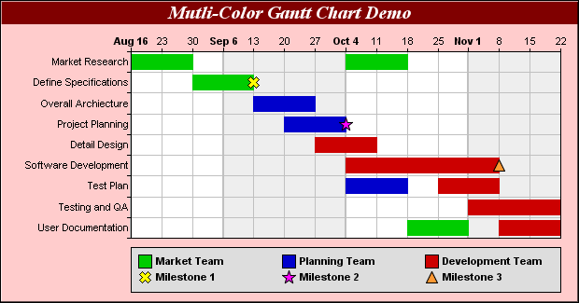
Network model
        Problem: A real estate developer wants to control costs and wants to finish building a new complex on time.
        Solution: She can use a Gantt chart to break large tasks into smaller components that can be tracked in time.
A chart like this can help a developer analyze, plan, and control timelines for the many different tasks that need to be done.

Slide 5
Inventory Analysis and Queuing theory
Inventory Analysis
Queuing Theory
Problem: Big Box retailer is trying to deal with pressures on profit margins by minimizing the cost of inventory, but must also avoid being out of stock
Solution: Help control inventories by mathematically tracking how much is purchased, and when, in order to automatically re-order at a specific level of in-stock inventory.
Problem: Grocery store is getting complaints about waiting times at the checkout during certain periods of the day.
Solution: Track peak hours and then allocate extra service personnel to the checkout stations for those specific times

Slide 6
Organizations as systems
Open systems
  Organizations that interact with their environments in the continual process of transforming resource inputs into outputs.
Systems Thinking
  Organizations are a collection of interrelated parts that function together to achieve a common purpose.
  Subsystems are the smaller components of a larger system.

Slide 7
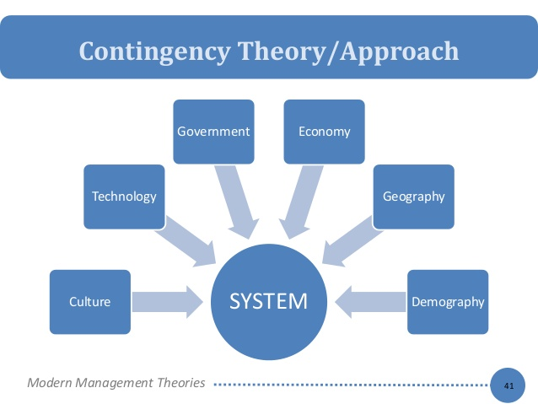
Contingency Thinking
Tries to match management practices with situational demands
Complete opposite to the rigidity of classical approaches to management
Looks at each problem or obstacle as needing unique approaches
There is NO “one-best-way” to approach every problem
Tight Bureaucracy works well when conditions are STABLE, but conditions are rarely stable, which means that contingency plans (back-up plans/new approaches) must be considered.
There are a number of factors that could cause instability for a company at any given moment.

Slide 8
Quality management
Quality and performance excellence
  Managers and workers in progressive organizations are quality conscious.
    Quality and competitive advantage are linked.
Principles to follow to ensure quality control
  Tally defects (how many boats did we toss?)
  Analyze and trace which step caused the defect.
  Make corrections
  Keep a record of what happened after corrections were implemented.
Total Quality Management (TQM)
  Comprehensive approach to continuous quality improvement for a total organization.
  Integrate principles of quality control into the organization’s strategic objective
Continuous Improvement – “There is always a better way” – Something can always be improved on.
ISO (International Organization for Standardization) Certification (Geneva, Switzerland) – High Quality certification completed by 3rd party auditors.

Slide 9
Evidence Based management (EBM):
High performance organizations
Tom Peters and Robert Waterman write a book on their on America’s Best-Run Companies
  Closeness to customers
  Bias towards action
  Simple form and lean staff
  Productivity through people
Most of these companies ended up failing ☹
New studies have shown that many long-lasting, high-performance companies demonstrate the following:
  People-oriented
  Team-oriented
  Information-oriented
  Achievement-oriented
  Learning-oriented

Slide 10
Ebm continued…
As nice as all of these observations are, they do not proved concrete, precise appraisals of companies
Companies want cold hard facts that will tell them what they should do
What is the best way to do a performance appraisal?
How do you select members for a high-performance team?
How should a merit-based pay system be structured and implemented?
Jeffrey Pfeiffer and Robert Sutton coined the term, EBM.
Did research on over 1000 firms and conducted tests, surveys and in-depth analysis of data in order to produce concrete facts about which approaches are most effective
Ex. Challenging goals that are accepted by employees actually result in higher performance than if goals were not challenged

Slide 11
21st century leadership
In order to survive in the 21st Century world of business, you must be open to learn, learn, learn.
You MUST commit to being a life-long learner; knowledge becomes obsolete. New information, technology, social and economic climates, government policies, among many other matters, are ALWAYS changing.
You must constantly update your portfolio, and adapt to the ever-changing world by learning how best to apply yourself.
The 21st Century Manager must be:
  A Global Strategist
  A Master of Technology
  An Inspiring Leader
  Actively Ethical

