Slide 1
Analysis of The Organization’s External Environment
Strategic management:
Analysing the Environment to prepare for the future

Slide 2
Analysis of The Environment
Political Environment
Economic Environment
Socio-Cultural Environment
Technological Environment

Slide 3
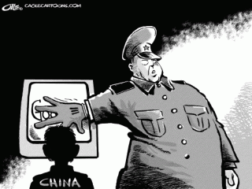
Political Environment
Existing and proposed laws and regulations
Government policies
Philosophies and objectives of political parties
Must monitor trends on political matters like health care, sales tax, environmental waste, military positioning
China v. Google over Beijing Olympics
Internet Censorship
Reporters Without Borders

Slide 4
Economic Environment
Rate of interest
State of inflation
Per capita income
Gross Domestic Product (GDP)
Economic progress trend
Rate of exchange
Production level
Employment/Unemployment Rate
Recession – Winners v. The Bay

Slide 5
Socio-Cultural Environment
The norms, customs, and social values on such matters as ethics, human rights, gender roles and lifestyles.
Environmental trends in education and social institutions
Demographic Patterns
Avg. Income $42, 305 – Avg. CEO Income 7.3 mil
In the past, 10% go out of their way for Environmentally sound Products v. Huge Surge
Sustainability, ethically produced, fair trade, green

Slide 6
Technological Environment
Current technology
Upcoming technology
Employee time spent using technology
Technological encroachment
Work expectations

Slide 7
PEPSI Politics
Political:
The manufacture, delivery, and use of numerous Pepsi products are subject to many federal regulations, like the Food, Drug and Cosmetic Act.
The business is also governed by government and foreign rules.
Their international business is subject to the political stability of foreign countries
Wars/civil unrest – Middle East continual issues
Entering developing markets – Monopoly on employable citizens

Slide 8
PEPSI Economics
Economic:
The products of Pepsi are influenced by the raw material yield being used in the soft drinks, juices, etc.
All distribution is affected by the cost of fuel
Operations in international markets involve the study of unpredictable changes in foreign exchange rate.
Pepsi is also subjected to availability of energy, supply of money, business cycles, etc.
Low Interest Rate – Opportunity to borrow more money
Strong USD

Slide 9
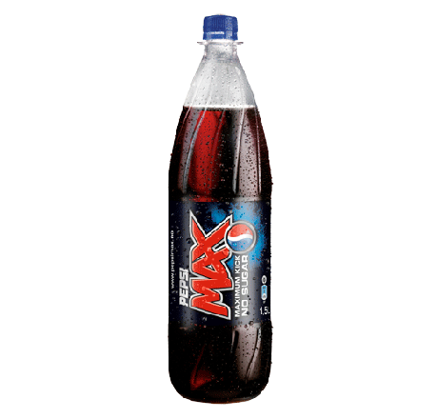
PEPSI Socio-Cultural
Social:
Feminine association with “diet” products - Pepsi Max
Move towards healthier choices – soft drinks are not looked at in a positive light
Popularity of reality T.V.

Slide 10
PEPSI Technology
Technology:
Company marketing, advertising and promotional programs: Recent development in technology of TV and internet use HD graphics. Products look more attractive especially if the HD is used on the television.
Vending machines: plastic bottles and cans have helped to increase sales for PepsiCo. because they can easily be carried and disposed after use and helped to increase sales because it saves on labour cost
PepsiCo .’s biggest factory is in New York: has a machine with the latest technology which can manufacture cans of PepsiCo drinks faster than bullets from a machine gun.

Slide 11
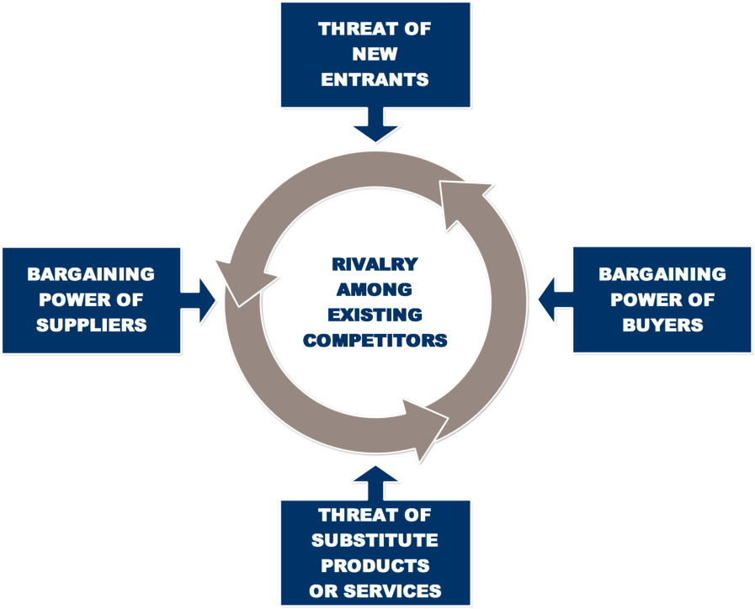
Porter’s Five Forces
A tool used to analyze risk (current and potential) from within an organization’s industry
Considers whether identified risks are Low, Medium or High Pressure

Slide 12
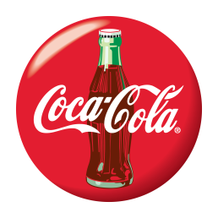
Rivalry Among Existing Competitors
Main competitor is Pepsi which also has a wide range of beverage products under its brand.
Both Coca-Cola and Pepsi are the predominant carbonated beverages and committed heavily to sponsoring outdoor events and activities.
Pepsi’s price point, taste, and brand power is on par with Coca-Cola
Other soda brands are present in the market (e.g. Dr. Pepper), but they have not seem the same success.
Threat Level: HIGH PRESSURE!!!!!

Slide 13
Threat of New Entrants
Entry barriers are relatively low for the beverage industry: there is no consumer switching cost
There is an increasing amount of new brands appearing in the market with similar prices to Coke
Coca-Cola is seen not only as a beverage but also as a brand. It has held a very significant market share for a long time (1892) and loyal customers are not very likely to try a new brand.
Threat Level: MEDIUM PRESSURE

Slide 14
Threat of Substitute Products
There are MANY kinds of energy drinks/sodas/juice products in the market.
Coca-cola doesn’t really have an entirely unique flavour. In a blind taste test, people can’t tell the difference between Coca-Cola and Pepsi.
Recent attention around the incredibly high quantity of sugar in the soda makes other drinks more appealing
Although there are many different beverages for consumers to drink , when choosing a soft drink, Coca-Cola is generally a “staple” choice
Threat Level: MEDIUM -HIGH PRESSURE

Slide 15
Bargaining Power of Suppliers
The main ingredients for the soft drink include carbonated water, phosphoric acid, sweetener, and caffeine. The suppliers are not concentrated or differentiated.
Because the ingredients are not rare, Coca-Cola will not have trouble obtaining the supplies they need
Coca-Cola is likely a large, or the largest customer, of any of these suppliers.
Threat Level: LOW PRESSURE

Slide 16
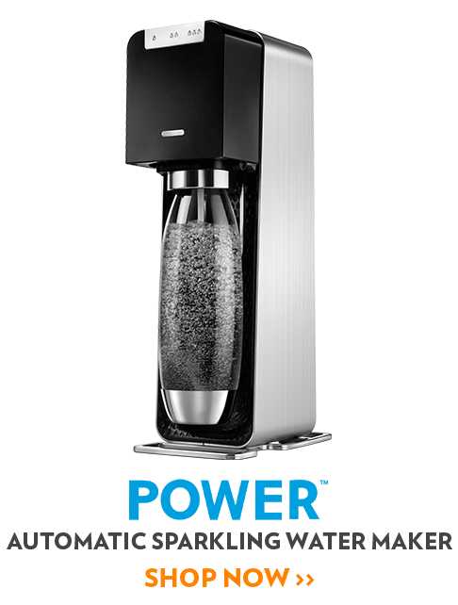
Bargaining Power of Buyers
The individual buyer (consumer) is brand-driven, loyal, and already familiar with the product
May switch to Pepsi because there is no switching cost, but if they are loyal to the brand, they will not be motivated to switch
Large retailers, like Wal-Mart, have bargaining power because of the large order quantity, but the bargaining power is lessened because of the end consumer brand loyalty.
Buyers are starting to value “green products” – Soda Stream might become a future threat
Threat Level: LOW PRESSURE

