Slide 1
Planning
Types of planning
&
Tools and techniques

Slide 2
The Planning Process
Steps in the planning process:
Define your objectives.
Determine where you stand in relation to your objectives.
Develop premises regarding future conditions.
Analyze and choose among action alternatives.
Implement the plan and evaluate results.

Slide 3
Types of Planning
Long-Range Plans - look 3 + years into the future
Intermediate-Range Plans – look 1-2 years into the future
Short-Range Plans – look up to 1 year into the future
Considering what we know about managers (Top, Middle and Lower-Level Management), how would each of these ranges fit in to their descriptions?

Slide 4
Types of Planning
Top Managers would use:
Long-Range Plans
Intermediate Managers would use:
Intermediate-Range Plans
Lower-Level Managers would use:
Short-Range Plans
WHY ARE EACH OF THESE PLANS IMPORTANT TO THE SUCCESS OF ORGANIZATIONS?

Slide 5
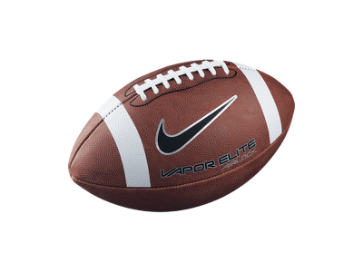
Strategic, Tactical and Operational Plans
Strategic Plans: Identifies long-term direction
Though they are long term, they can also be dynamic
Guided by the organization’s overall vision
Tactical Plans: The intermediate-range “moves” a business makes in order to see the organization’s vision come to fruition.
Use Functional Plans in order to break a strategy apart in to manageable components
Production Plans, Financial Plans, Facilities Plans, Logistics Plans, Marketing Plans, Human Resource Plans

Slide 6
Operational Plans
Short term plans that support the strategic plan
Policies – A standard plan that communicates broad guidelines for decisions and actions (i.e. Every TBY student must wear a TBY uniform)
Procedures or Rules – The precise actions that are taken in SPECIFIC situations (i.e. Lockdown procedures)
Budgets – A plan that commits resources ($$$) to projects or activities. Over budget = ☹, but Under budget = ☺

Slide 7
Types of Budgets
Financial Budgets: cash flows and expenditures
Operating Budgets: How much will be earned vs. how much will be spent
Non-Monetary Budgets: accounts for labour, equipment and space
Fixed Budget: Set amount of money for a specific purpose
Flexible Budget: resources used on variable expenditures
Zero-Based Budgets: Each budget must start anew without consideration for “rolled-over” resources

Slide 8
Planning Tools and Techniques
Forecasting: The process of predicting what will happen in the future
Very unpredictable – they are planning aids, NOT substitutes!
Elvis Presley – Human judgement can be wrong

Slide 9
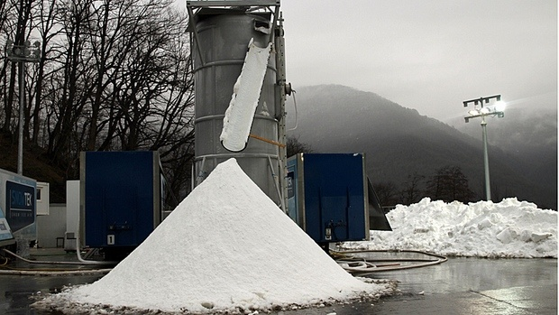
Tools and Techniques
Contingency Planning: Identifies alternative courses of action to take when things go wrong
Not always effective when situation is unstable, but better than not having a contingency plan
2010 Vancouver Winter Olympic on Cypress Mountain
Coke and Pepsi vs. Iraq (Mecca and Qibla Cola)

Slide 10
Tools and Techniques
Scenario Planning: Identifies several future scenarios and makes plans to deal with each one – good or bad!
A long-term version of contingency planning
Royal Dutch/Shell
What will happen when the oil runs out?
What will happen if political strife in the middle east heightens?
What will happen if new laws are made to decrease the use of oil?
What will happen if our governments will work together to fairly distribute oil?
What will happen if our competitors begin to bow out of the oil industry due to increasing pressures?
What will happen if we are hold the greatest stake in oil in North America?

Slide 11
Tools and Techniques
Benchmarking: Uses internal and external comparisons to plan for future improvements
Combats complacency – Challenges the Status Quo
Look to other organizations/companies to see what they are doing well and how those ideas can be integrated into your company
Best Practices: Strategies, techniques, efficiencies that will help others achieve superior performance.
Internal Benchmarking: Sharing Best practices within an organization
External Benchmarking: Sharing best-practices amongst competitors and non-competitors (Reciprocity)
Zara: Benchmarking “Fast Fashion”

Slide 12
Tools and Techniques
Use of Staff Planners: specialists who are employed to help coordinate and energize planning
Skilled in all steps of the planning process and in utilizing Tools and Techniques
Cisco Systems China → India
CCL Industries → Host Labeling and Packaging factories worldwide to ease workload
Problem: As strong as Planners and their plans might be, unless line workers and Staff Planners work closely together, employees will likely be unmotivated to implement new plans

Slide 13
Implementing Plans to Achieve Results
A Plan not Implemented is Useless.
Goal Setting
Setting a general goal can often lead to an organization’s downfall. General goals may spawn complacency and an unclear vision
To combat generalities, managers begin assessing their company through SMART goals

Slide 14
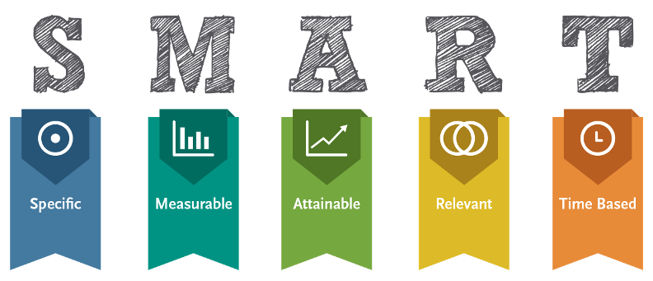
Goal Setting: SMART Goals

Slide 15
SMART Goals
Specific - Should be clear about what you want to happen
Not Specific: I want to make good grades
Specific: I want to have a 93 average in science by May 26th 2016
Measurable – Worded so that results can be measured
Not Measurable: I want to make a lot of free throw shots
Measurable: I want to make at least 9 out of 10 free throw shots in the next basketball game
Attainable – Challenging enough to move you forward, yet realistic enough that they can be achieved
Unattainable: To get a job that will earn me $120, 000 straight out of high school
Attainable: By the time I am 35 years old, I want to have finished a Master’s Degree in Engineering and will hold a position that earns me a salary of $120, 000
Relevant (Referred to) – Makes sense in relation to context
Not Relevant: Barracuda
Relevant: TD Bank savings plans with higher interest for teens who are saving for college
Time Based –Linked to specific timeframes and due dates
No time: Middle-managers will receive a raise of 2%
Time: Middle-managers will receive a raise of 2% which will come into effect on the pay-period after next

Slide 16
Goal Alignment
Mission and Purpose
Top Management Objective
Senior Management Objective
Middle Management Objective
Front-Line Management Objective
Serve the world as the number one supplier of recyclable food containers
Firm – Deliver error-free products meeting customer requirements 100% of the time
Manufacturing Division – 100% on-time production of error-free products
Plant – increase error-free product acceptance rate by 16%
Shift Supervisor – Assess machine operator skills and train for error-free production

