Slide 1
Unit 1: Foundations of Management
Chapter 1: Management Fundamentals

Slide 2
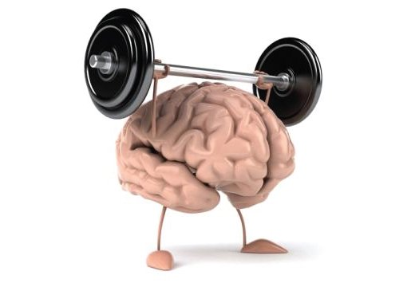
Talent Vocabulary
Intellectual Capital: is the collective brainpower or shared knowledge of a workforce.
Intellectual Capital=Competency X Commitment
Knowledge Workers: are those employees whose minds are critical assets to their employers.

Slide 3
Talent
Companies must recognize the gifts, talents, and abilities of their workers and must utilize their skilled workers effectively!
The ultimate foundation of a company’s success is in their employees and their talents.
There is great value in developing employees skills, talents, and abilities, as it is an investment in the company’s future too.

Slide 4
Diversity Vocabulary
Workforce Diversity: describes differences among workers in gender, race, age, religion, sexual orientation, and able-bodiedness.
Prejudice: is the display of negative, irrational attitudes toward members of diverse populations.
Discrimination: actively denies memebrs of society the full benefits of organizational membership.

Slide 5
Diversity
The composition of a company in terms of gender, race, age, ethnicity, religion sexual orientation, and able-bodiedness.
Very hot topic
Issue of “making their numbers”
Diversity could bring a lot of gains to a company. How?

Slide 6
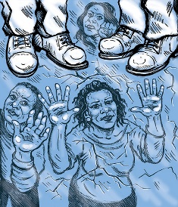
Diversity Vocabulary
The Glass Ceiling Effect: an invisible barrier limiting career advancements of women and minorities
Sticky Floor: Keeping women and minorities stuck at the bottom of the economic pyramid

Slide 7
Globalization
Globalization: is the worldwide interdependence of resource flows, product markets, and business competition.
Impacts: availability of products, types of products, product price, employment opportunities, income, environmental policies, business competition.
Opportunities and Challenges
https://www.youtube.com/watch?v=pjiq-ObPhF0

Slide 9
Technology
Major player in the Globalization of resources, services, and employment.
Communication: (email, text, phone calls, cell phones, blogs, social media, Skype, BBM)
Advancements/Efficiencies: Barcodes, self-checkouts, gift cards, apps etc.
Opportunities and Challenges?

Slide 10
Ethics Vocabulary
Ethics: A set moral standards of what is “good” and “right” in the conduct of a person or group.

Slide 11
Ethics
Enron
Unilever
Herb Baum (CEO of Dial) – Income swap!
Reuben Mark (CEO of Colgate) – Return of classified information
Environment, sustainability, protection of consumers through product safety and fair practices, human rights ...

Slide 12
Careers Vocabulary
Full Time Core Workers: pursue traditional career paths, can advance in an organization and may be employed for a long time.
Independent Contractors: perform specific tasks and are compensated on a fee-for-service basis. May be employed by more than one employer.
Part-time workers: hired only as needed and for as long as needed.
Portfolio workers: has up-to-date skills that allow for job and career mobility.

Slide 13
Careers
The Shamrock Organization (Charles Hardy)
Mobility between types of careers
When would each “leaf” be most fitting in one’s life?
Upgrading skills, education, and qualifications in order to mobilze.

